Slide 1
(made up numbers, these are not the true answers for this class)
1
2
3
4
1,2
1,3
2,3
1,4
2,4
3,4
1,2,3
1,2,4
1,3,4
2,3,4
On the small dataset
Two are strongly related to the class (and to each other)
One is weakly related to the class
The rest are random.
Thus for say, 65, the answer should be…
[4 7 9] accuracy 0.89
You might have gotten
[4 9] accuracy 0.94 or [4 9 2] accuracy 0.95 etc
This counts as a success, the small size of the training data, means you might have missed the weak feature, and you might have added a random feature that adds a tiny bit of spurious accuracy. So long as you got the two strong features, all is good.
1,2,3,4

Slide 2
(made up numbers, these are not the true answers for this class)
1
2
3
4
1,2
1,3
2,3
1,4
2,4
3,4
1,2,3
1,2,4
1,3,4
2,3,4
On the big dataset
Two are strongly related to the class (and to each other)
One is weakly related to the class
The rest are random.
Thus for say, 65, the answer should be…
[50 91 16] accuracy 0.91
Here many people will get something like…
[50 91 2 7 55 95 7 22] accuracy 0.99
What is going on? With so many extra features to search thru, some random features will look good by chance.
1,2,3,4

Slide 3
Greedy Forward Section
Initial state: Empty Set: No features
Operators: Add a feature.
Evaluation Function: K-fold cross validation.
1
2
3
4
100
80
1,2
1,3
2,3
1,4
2,4
3,4
60
40
1,2,3
1,2,4
1,3,4
2,3,4
20
0
{}
{3}
{3,4}
{1,3,4}
1,2,3,4

Slide 4
1
2
7
91
0.9
0.8
50
0.7
0.6
0.5
0.4
0.3
0.2
[50 91 2 7 55 95 7 22] accuracy 0.99
0.1
0
0
5
10
15
20
25
Default rate

Slide 5
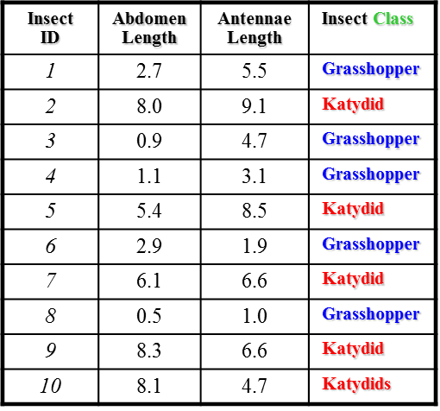
A simple trick to test for “real features”
Make several copies of your dataset.
In each copy randomly delete a small faction of the instances, say 5%
Run you search algorithm on each of these datasets
Look at the results….
[91 50 2 7 55 95 7 22] accuracy 0.99
[50 91 1 18 95 16 29] accuracy 0.98
[50 91 19 22 33 45 18] accuracy 0.93
[50 91 43 2 56 32 11 23] accuracy 0.99
[91 50 36 56 79 16 12] accuracy 0.94
[50 91 16 2 12 67 23 45] accuracy 0.98

